Slide 1

RMD Sinhgad School of Engineering Department of Computer Engineering “Face Recognition On The Basis Of Sketch”
Presented By:
Swapnil Sohale
Atharv Deshpande
Viraj Bhise
Dnyaneshwar Bhendekar
Guide Name: Mrs. Jyoti Raghatwan
Dept. of Computer Engineering, RMDSSOE

Slide 2
Introduction
Sketch based facial recognition has been well developed in recent years for its widely application on law enforcement. In this technology an experienced artist draws a sketch about the suspect according to the description of the witness. Then the sketch is transformed to a photorealistic face image. At last, the synthesized face photo is compared to the images from face datasets to find the suspect.
This project will allow users to produce facial images from rough or even incomplete freehand sketches without prior knowledge of drawing techniques.
Dept. of Computer Engineering, RMDSSOE

Slide 3
Objectives
To perform various operation such as Pre-processing , Edge Detection , Feature Extraction etc. on sketches.
To analyse the sketch and produce photorealistic facial images using CNN algorithm.
The fusion of proposed architecture and deep learning algorithm will help to improve the performance and accuracy of facial recognition process.
Dept. of Computer Engineering, RMDSSOE

Slide 4
Problem Statement
Sketch based face recognition has become a popular area of research in computer vision, mainly due to increasing security demands, forensic investigation for criminal suspects and its potential, commercial and law enforcement applications.
It is a very challenging problem and up to date and there is no feasible technique that provides a robust solution to all situations and different applications that forensic face sketch recognition may encounter.
This project focuses on developing a technique that provides a solution for an efficient face sketch identification system by improving the performance and accuracy .
Dept. of Computer Engineering, RMDSSOE

Slide 5

Concepts
Facial Recognition
Face recognition is a method of identifying or verifying the identity of an individual using their face. This process is carried out by using advanced computer algorithms. Face recognition systems can be used to identify people in photos, video, or in real-time. Law enforcement may also use mobile devices to identify people during police stops.

Slide 6
Sketch Based Facial Recognition
A forensic artist prepares the sketch of the person as described by the eyewitness. Sometimes the sketch is not accurate enough to find the person , so we need a dedicated facial recognition system that will analyse the provided sketch and then produce realistic photo output from it and match it with the database to identify the person.

Slide 7
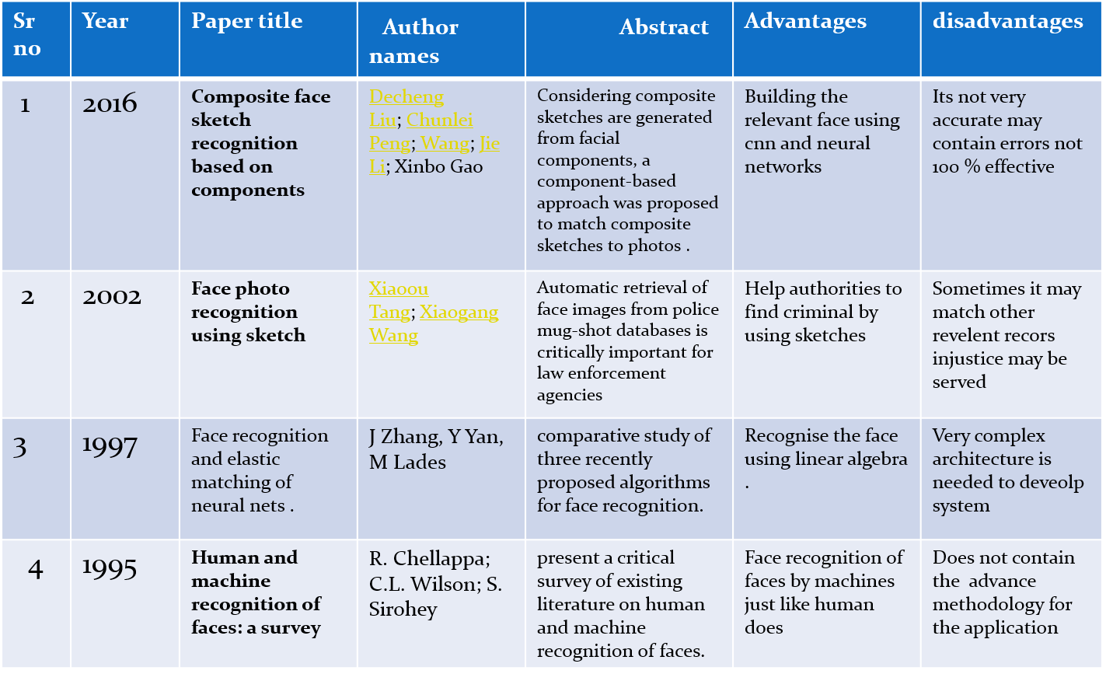
Literature Survey

Slide 8
Sr No | Year | Paper Title | Author Names | Abstract | Advantages | Disadvantages
5 | 1993 | ATTRIBUTE-CONTROLLEDFACEPHOTOSYNTHESISFROM SIMPLE LINE DRAWING | Qi Guo Ce Zhu Zhiqiang Xia Zhengtao Wang Yipeng Liu | Face photo synthesis from simple line drawing is a one-to many task as simple line drawing merely contains the contour of human face. to complicated natural scenes | Task is simple as line drawing | Previous example based methods are over-dependent on the datasets and are hard to generalize
6 | 2005 | A research on face cognition method with deep ensemble learning and feedback mechanism | Fan Yeping, Yang Desheng, Ma | Face recognition technology is an import ant researchfieldfordeeplearning. In order to overcome the shortcomings of traditional open-loop face cognition mode and deep neural network structure | open-loop face cognition mode and deep neural network structure | Hard to detect face from sketch images
7 | 2010 | Real-Time and Accurate Face Detection Networks Based on Deep Learning | Shuangq in Wang | . In this paper, we propose a real-time and accurate face detection network based on Mobile Nets, SSD (Single Shot Multi Box Detector) and FPN(Feature Pyramid Networks). | Face detection is quite accurate here | Problems related to sililarity measures not available

Slide 9
Sr No | Year | Paper Title | Author Names | Abstract | Advantages | Disadvantages
8 | 2021 | Picture completion reveals developmental change in representational drawing ability: An analysis using a convolutional neural networkG | Anja Philippsen, Sho Tsuji and Yukie Nagai | Drawings of children may provide unique insights into their cognition. Previous research showed that children's ability to draw objects distinctively develops with increasing age. | Representation ofdrawing styles in different network layers | Detection can be vulnerable. We’ve outlined the way in which facial detection can be thrown off;
9 | 2017 | Sketch-based Manga Retrieval using Deep Features | Rei Narita, Koki Tsubota, Toshihiko Yamasaki, Kiyoharu Aizawa | Manga, Japanese comics, are globally popular, and the digital manga (e-manga) market is growing year by year. E_x0002_manga has a limitation in its search methodology | This search methodology cannot take images of manga into account. | it was difficult to collect and use manga images for research because of copyright issues.
10 | 2018 | MULTI-LABEL NETWORKS FOR FACE ATTRIBUTES CLASSIFICATION | Sara Atito Aly .Berrin Yanikoglu | Face attributes classification is drawing attention as a research topic with applications in multiple domains, such as video surveillance and social media analysis. | Better security. Face detection augments surveillance tactics and forms the basis of the identification process of terrorists and criminals | Huge storage requirements. Machine learning technology requires powerful data storage;

Slide 10



Software and Hardware Requirment
Hardware Requirement:
RAM : 8 GB
Hard Disk : 40 GB
Processor : Intel i5 Processor
Software Requirement:
IDE : Spyder
Coding Language : Python Version 3.8
Operating System : Windows 10

Slide 11
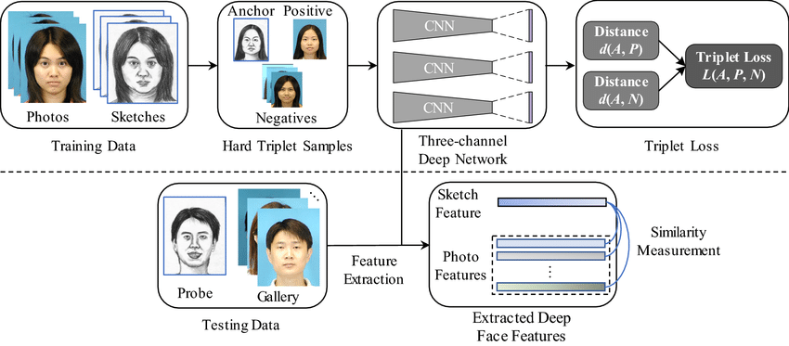
Algorithm We Are Using
A Convolutional Neural Network (ConvNet/CNN) is a Deep Learning algorithm which can take in an input image, assign importance (learnable weights and biases) to various aspects/objects in the image and be able to differentiate one from the other.

Slide 12
WHY CNN ??
CNNs are used for image classification and recognition because of its high accuracy
CNNs are trained to identify the edges of objects in any image.
Images have high dimensionality (as each pixel is considered as a feature) which suits the above described abilities of CNNs.

Slide 13
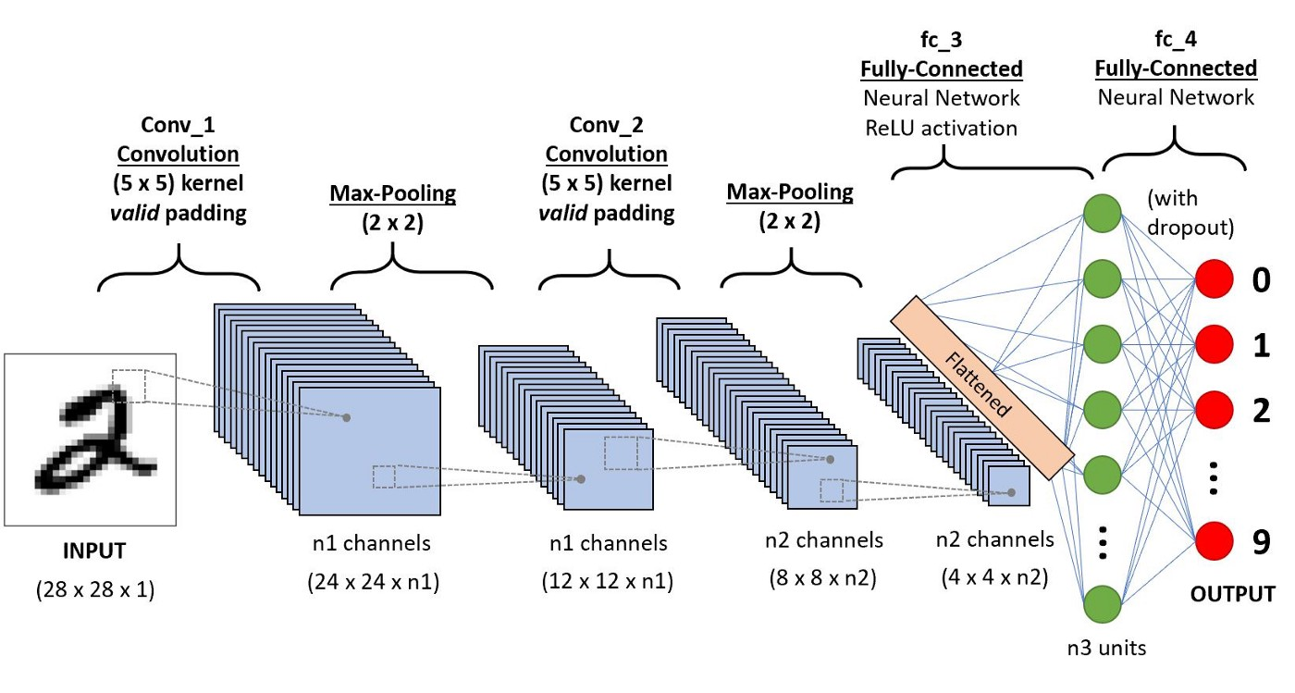
HOW WILL IT WORK
Each input image will pass it through a series of convolution layers with filters
In order to perceive the same as humans, CNNs have digital color images that have red-blue-green (RGB) encoding
There is a Convolutional Layer, Activation Layer, Pooling Layer, and Fully Connected Layer, these are all interconnected so that CNNs can process and perceive data in order to classify images

Slide 14
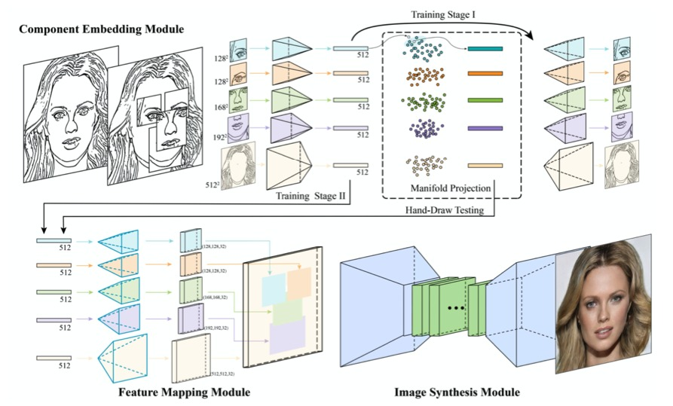
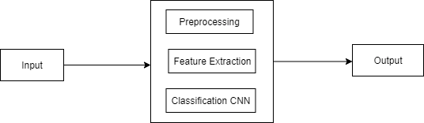
DFD

Slide 15
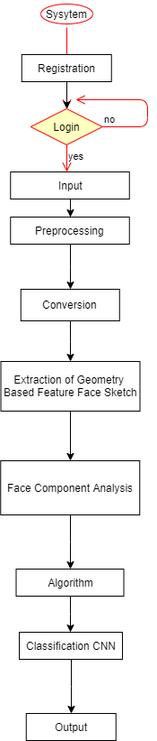
Activity Diagram

Slide 16
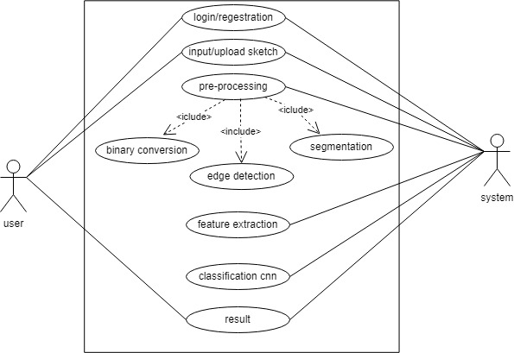
Use Case Diagram

Slide 17
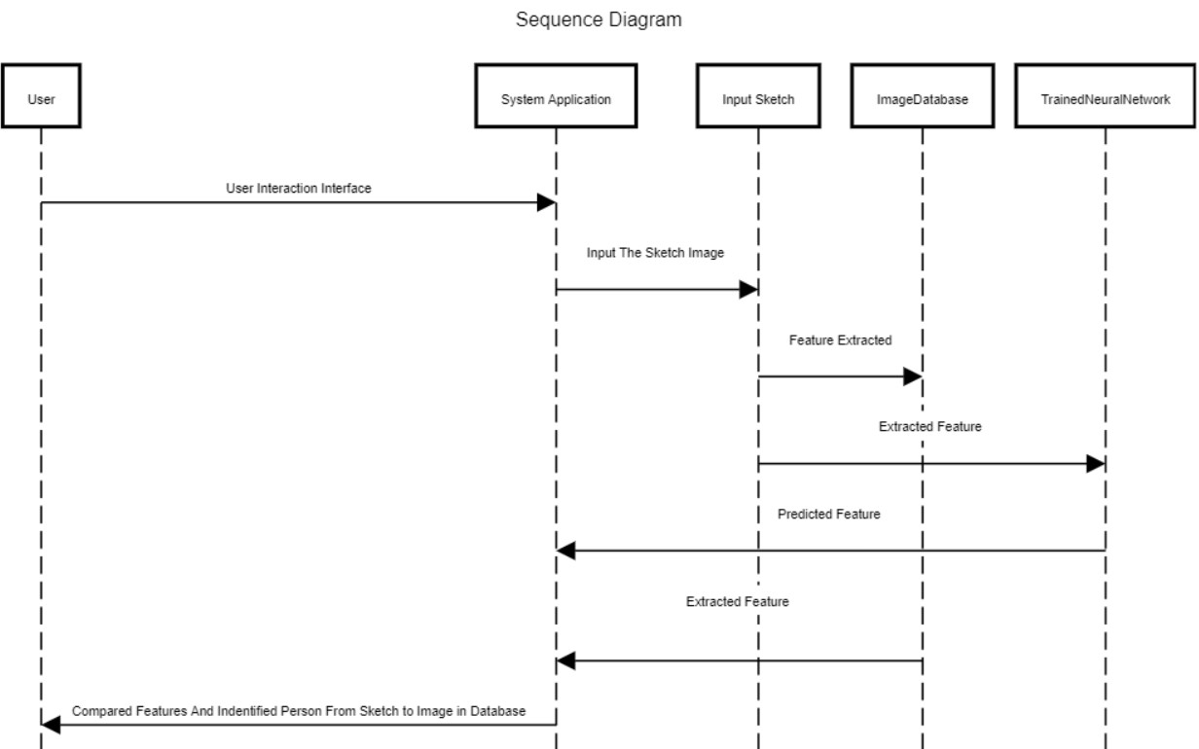
Sequence Diagram Of Our System

Slide 18





Technology We Are Using
PILLOW LIBRARY
These Are The Python Libraries We Are Using in Our Project

Slide 19
Future Scope Of Domain
Airplane Boarding System
Handwritten Character Recognition System
Automated Surveillance
Sketch Based Face Reconstruction
Forensic Department
Criminal Investigation Database

Slide 20
Conclusion
This proposed work aims to provide an optimal solution for facial recognition of faces based on sketch. It will improve the process of image synthesis using geometrical based feature extraction.
The noisy input image will gradually optimized for clear facial image. The result could express sharp sketches and avoid mosaic effect and blurry parts

Slide 21
References
W. Zhang, X. Wang, and X. Tang, “Coupled information-theoretic encoding for face photo-sketch recognition,” in IEEE CVPR, 2011, pp. 513–520.
2 T. Isenberg, P. Neumann, S. Carpendale, M. C. Sousa, and J. A. Jorge, “Nonphotorealistic rendering in context: An observational study,” in ACM NPAR, 2006, pp. 115–126.
3 A. Gooch, B. Gooch, P. Shirley, and E. Cohen, “A non photorealistic lighting model for automatic technical illustration,” in ACM SIGGRAPH, 1998, pp. 447–452.
4 G. Winkenbach and D. H. Salesin, “Computer-generated pen-and ink illustration,” in ACM SIGGRAPH, 1994, pp. 91–100

